Slide 1
PHP – Working with Input
Neil Buckley
bucklen@hope.ac.uk
FML308B

Slide 2
HTML, CSS, JavaScript and PHP
<html>
<head>
<style rel=“stylesheet”
type=“text/css”
href=“mystyle.css” />
<title>Page Title</title>
<script>// Your Scripts</script>
</head>
<body>
<p>Page Content</p>
<?php echo(“<p>More content</p>”); ?>
</body>
</html>

Slide 3
What will we cover
To review how to create HTML input forms
How to access user input
How to handle multiple selections
Form submission
Reading in Files and Interpreting
To learn how to pass data from HTML forms to PHP scripts
Externally
Internally
Each lecture we cover, you should be thinking how this will apply to your assessment

Slide 4
Forms
User input is more often than not obtained using forms and form elements
What happens to the data from the form is dictated by the action attribute in the form tag

Slide 5
HTML5 form attributes
placeholder autofocus autocomplete
required pattern list
multiple novalidate formnovalidate
form formaction formenctype
formmethod formtarget
Careful when using these features not all browsers support the attributes

Slide 6
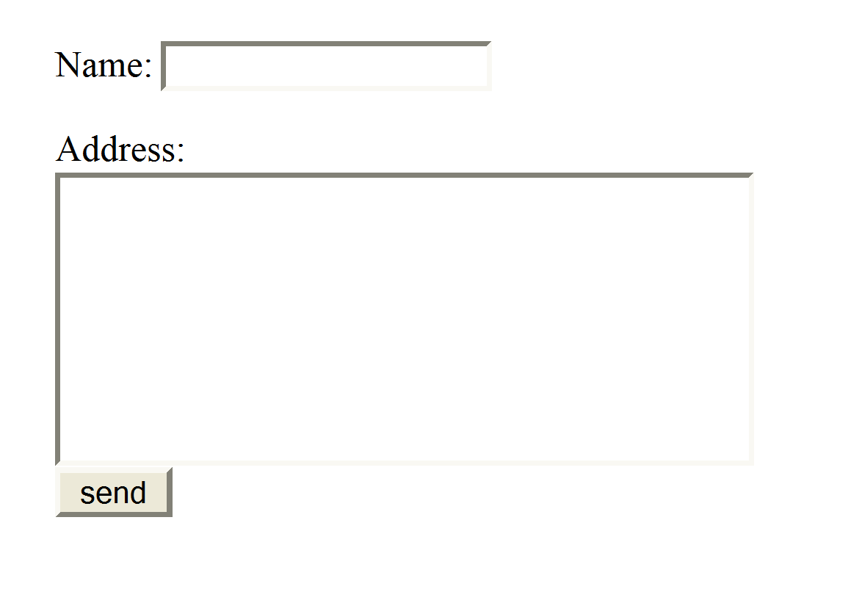


A Simple HTML Form
<form action="form_listing.php" method="post">
<p>Name:
<input type="text" name="user" id="user" /></p>
Address: <br />
<textarea name="address" id="address" rows="5" cols="30"></textarea><br />
<input type="submit" value="send" />
</form>
user
Stewart
Address of Envelope: form_listings.php
Contents of Envelope: information for user
information for address

Slide 7
What happens if you click send?
In this case the form will attempt to send the data to a PHP page called form_listing
What happens if the page does not exist?
Not Found
The requested URL /form_listing.php was not found on this server.
Apache/2.0.47 (Win32) PHP/4.3.3 Server at localhost Port 80

Slide 8
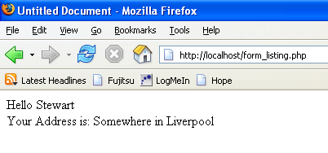
form_listings.php
<?php
echo "Hello ".$_POST[‘user’]."<br />";
echo "Your Address is:".$_POST[‘address’];
?>
user
Stewart

Slide 9
Let’s break it down
Two Separate Files
Creates a single global variable – an array!
The array has two elements
NORMALLY you would move to a local variable
<form action="form_listing.php" method="post">
<p>Name:
<input type="text" name="user" id="user" /></p>
Address: <br />
<textarea name="address" id="address" rows="5" cols="30"></textarea><br />
<input type="submit" value="send" />
</form>
<?php
echo "Hello ".$_POST[‘user’]."<br>";
echo "Your Address is:".$_POST[‘address’];
?>

Slide 10
Radio Buttons
<input name="radiobutton" type="radio" value="brady" />
<input name="radiobutton" type="radio" value="learmond" />
<?php
$myLocalVariable = $_POST[‘radiobutton’];
echo (“selected was:” . $myLocalVariable);
?>

Slide 11
The values passed
The values passed so far have been one value per control.
The same principles apply to all form elements that pass one value
What if we wanted to pass more than a single value from a predefined list. For example a select control list or check boxes?

Slide 12
The Code
<form action="form_listing.php" method="post">
<p>Name:<input type="text" name=“user” id="user" /></p>
Address: <br /> <textarea name="address" id="address"
rows="5" cols="30"></textarea><br />
<select name="course[]" multiple>
<option value="NOS">Networks and OSs</option>
<option value="WebDev">Web Site Development</option>
<option value="ITBA">IT Business Applications</option>
<option value="DBTECH">Database Technology</option>
</select>
<input type="submit" value="send" />
</form>

Slide 13
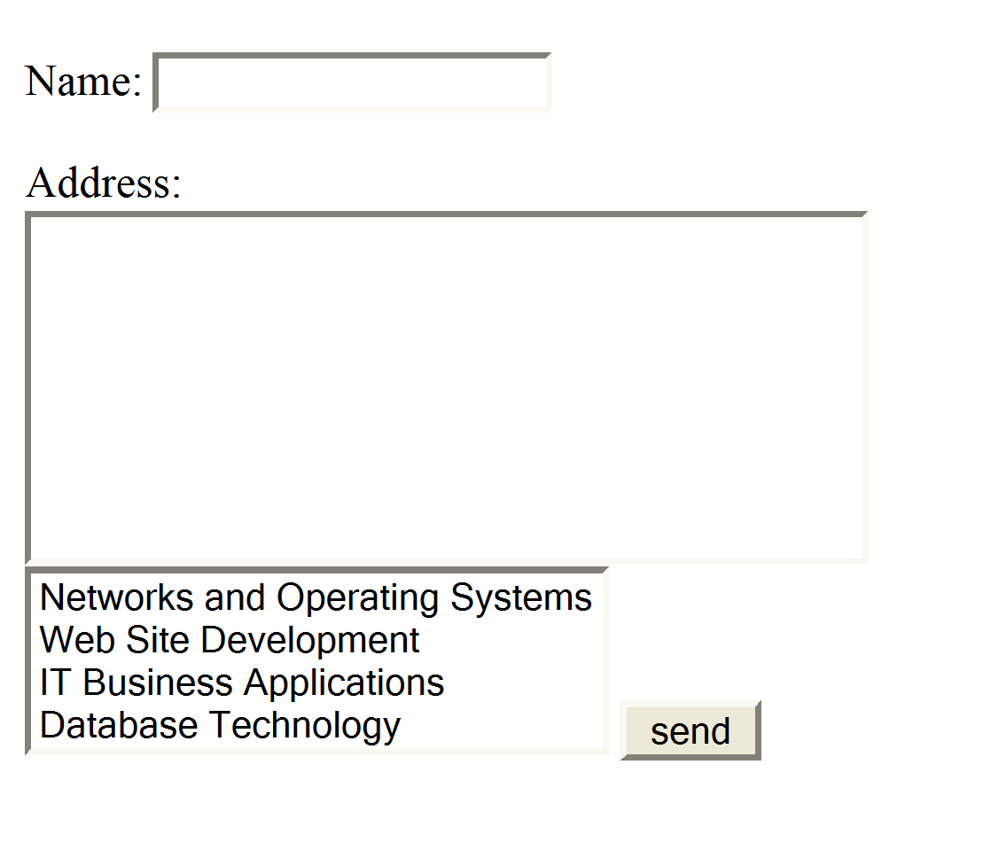
This produces
name=“user”
Stewart
name="address"
Somewhere in Liverpool
name=“course[]”
Networks and Operating Systems
Website Development

Slide 14
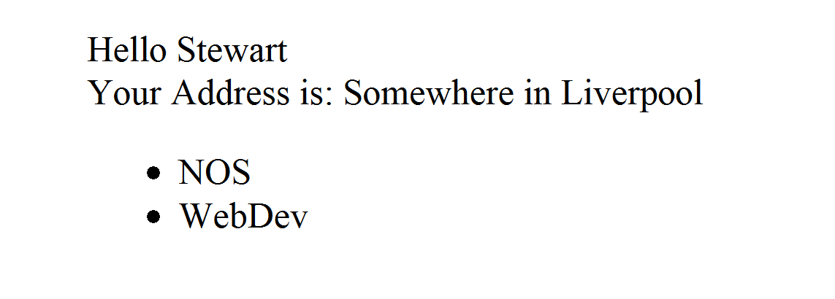
Form Listing
<?php
echo "Hello ".$_POST[‘user’]."<br />";
echo "Your Address is: ".$_POST[‘address’];
if (!empty($_POST[‘course’]))
{
echo "<ul>";
foreach ($_POST[‘course’] as $value)
{
echo "<li>".$value."</li>";
}
echo “</ul>”;
}
?>
What will be echoed out?
Try to remember, the value stored is not necessarily what the user sees!

Slide 15
Form Listing
<?php
echo "Hello ".$_POST[‘user’]."<br>";
echo "Your Address is: ".$_POST[‘address’];
if (!empty($_POST[‘course’]))
{
echo "<ul>";
foreach ($_POST[‘course’] as $value)
{
echo "<li>".$value."</li>";
}
echo “</ul>”;
}
?>

Slide 16
Form Listing
<?php
echo "Hello ".$_POST[user]."<br>";
echo "Your Address is: ".$_POST[address];
if (!empty($_POST[course]))
{
echo "<ul>";
foreach ($_POST[course] as $value)
{
echo "<li>".$value."</li>";
}
echo “</ul>”;
}
?>

Slide 17
PHP File Handling
Part of your assessment requires you to read input from a file
List of Students to automatically enrol on a course
Questions in a Quiz
Outputting to a file is also useful
Students enrolled on a course (for registers?)
Student Marks

Slide 18
PHP File Handling - Opening a File
<?php
$file=fopen(“list.txt","r");
?>
Modes | Description
r | Read only. Starts at the beginning of the file
r+ | Read/Write. Starts at the beginning of the file
w | Write only. Opens and clears the contents of file; or creates a new file if it doesn't exist
w+ | Read/Write. Opens and clears the contents of file; or creates a new file if it doesn't exist
a | Append. Opens and writes to the end of the file or creates a new file if it doesn't exist
a+ | Read/Append. Preserves file content by writing to the end of the file
x | Write only. Creates a new file. Returns FALSE and an error if file already exists
x+ | Read/Write. Creates a new file. Returns FALSE and an error if file already exists

Slide 19
PHP File Handling - Opening a File
<?php
$file=fopen("list.txt","r") or exit("Unable to open file!");
?>
Modes | Description
r | Read only. Starts at the beginning of the file
r+ | Read/Write. Starts at the beginning of the file
w | Write only. Opens and clears the contents of file; or creates a new file if it doesn't exist
w+ | Read/Write. Opens and clears the contents of file; or creates a new file if it doesn't exist
a | Append. Opens and writes to the end of the file or creates a new file if it doesn't exist
a+ | Read/Append. Preserves file content by writing to the end of the file
x | Write only. Creates a new file. Returns FALSE and an error if file already exists
x+ | Read/Write. Creates a new file. Returns FALSE and an error if file already exists

Slide 20
PHP File Handling – Reading from the file
<?php
$file = fopen("list.txt","r"); fgets($file);
?>
fgetc($file);

Slide 21
PHP File Handling – Reading from the file
<?php
$file = fopen("list.txt","r"); echo (fgets($file)); $line = fgets($file);
?>

Slide 22
PHP File Handling – Closing a File
<?php
$file = fopen("test.txt","r"); $line = fgets($file);
fclose($file);
?>

Slide 23
PHP File Handling – End of File?
PHP can check to determine if it is the end of file.
if (feof($file))
{
echo (“End of File”);
}
feof($file);
while (!feof($file))
{
$line = fgets($file);
}
echo (“End of File Reached”);

Slide 24
Passing Data to the Same Page
Sometimes you may want to pass data to the same page
Consider the following example
If submit not clicked display form
Else do something with data (typically you will add to the database)

Slide 25
The Structure
if ($_POST[viewed] != "yes")
{
// display form for input
}
else
{
// process data
}
if (isset ($_POST[‘formElementName’]))
{
// process data
}
else
{
// display the form for input
}

Slide 26
Requirements
action in the form needs to be set to $_SERVER[‘PHP_SELF’]
the form needs a hidden field called viewed
or if using isset an existing form element
viewed must be set to yes once the form has been displayed
or a value associated with the form element
Works better once you begin using functions!
This will be revisited

Slide 27
What have we covered?
Forms Recap
Passing data as a global variable
Accessing the data from the global variable
Radio Buttons
Multiple Selections
File Input
We also touched on Flow Control and Arrays. These are covered in much more detail over the next few weeks.

Slide 28
Any Questions?

